Slide 1
Case Study: Newsvendor Problem
Dr. Xueping Li
University of Tennessee

Slide 2
Setup
Rupert sells daily newspapers on street
Rupert buys for c = $0.55 each, sells for r = $1.00 each
Each morning, Rupert buys q copies
q is a fixed number, same every day
Demand during a day: D = max (⎣X⎤, 0)
X ~ normal (μ = 135.7, σ = 27.1), from historical data
⎣X⎤ rounds X to nearest integer
If D ≤ q, satisfy all demand, and q – D ≥ 0 left over, sell for scrap at s = $0.03 each
If D > q, sells out (sells all q copies), no scrap
But missed out on D – q > 0 sales
What should q be?

Slide 3
Formulation
Choose q to maximize expected profit per day
q too small – sell out, miss $0.45 profit per paper
q too big – have left over, scrap at a loss of $0.52 per paper
Classic operations-research problem
Many versions, variants, extensions, applications
Much research on exact solution in certain cases
But easy to simulate, even in a spreadsheet
Profit in a day, as a function of q:
W(q) = r min (D, q) + s max (q – D, 0) – cq
W(q) is a random variable – profit varies from day to day
Maximize E(W(q)) over nonnegative integers q

Slide 4
Solve it using Simulation
Build the model
Challenges
Tips:
Conversion of double data to int.
E.g. (int)normal (sigma, mu)

Slide 5
Solve it using Simulation
Questions:
What’s the profit if Rupert bought 100 news papers?
1. Using random seed 1, one run only
2. What’s his long-term expected profit? Using multiple runs (1000). Add a plot showing the profit of each run. Add a “statistics” to calculate the overall mean profit.
What’s the profit if Rupert bought 200 news papers?
1. Using random seed 2, one run only
2. Long-term expected profit. Using multiple runs (1000). Add a plot showing the profit of each run. Add a “statistics” to calculate the overall mean profit.

Slide 6
Solve it using Simulation (cont.)
What’s Rupert’s long-term strategy (how many news papers to buy) and his expected profit? (Use OptQuest)

Slide 7
Discussions
How can I “manually” obtain the near optimal solutions using “Parameters Variation”?
Regression analysis?

Slide 8
Solutions
To be revealed …

Slide 9
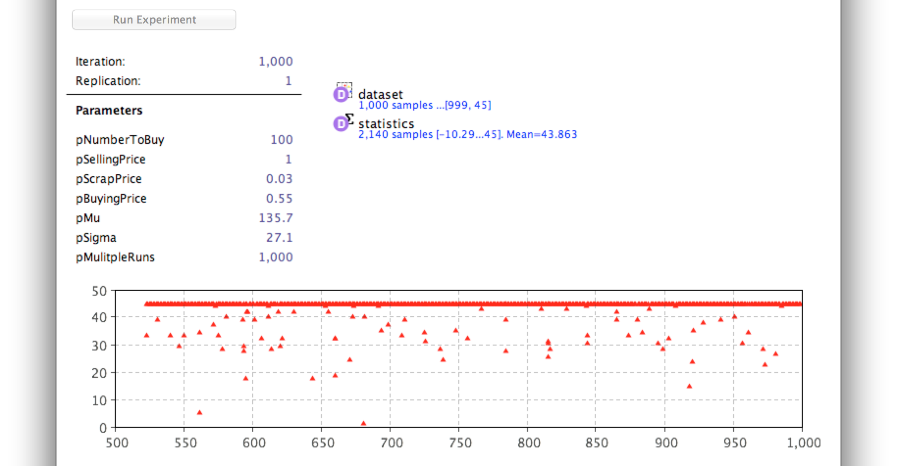
Screenshots

Slide 10
